Slide 1
System Refresh Training Program
July 2018

Slide 2
Agenda
System Refresh Concept
Pre-study of Source and Target System
System Refresh Procedure
Pre Task- Source System
Pre Task- Target System
Database Copy(Restore and Recovery)
Post- Refresh Activity
Questions

Slide 3
System Refresh Concept

Slide 4
What is System Refresh?
System Refresh is a copying of data from source to target SAP System.
This scenario is normally used to refresh Quality / Sandbox with Production Data to facilitate accurate UAT for all business scenarios.
There are two ways to do system refresh
1.Backup Restore
It Requires minimum System downtime.
SAP Best Practice
2.Export - Import
Increase in downtime during export of database on source system

Slide 5
Pre-study of Source and Target System.

Slide 6
Pre-study of Source and Target System.
Study on the Current Utilization of resources on Target system and Source System.
Check the available CPU's & memory on the Target hardware and Source System.
Compare the database sizes of Target hardware and Source System.
Compare the existing FS & current utilization of the same on Target system and Source System.
Study the systems integrated to Sandbox in SM59( Configuration of RFC connection). There are three ways to do it:
1.Take Screenshots of the Configurations.
2.By doing Table Export(using R3Trans Utility)
3.By saving tables in TOC (transport of copies using SE01)
Some interfaces are connected to TARGET or other (mainly to PI) on a special requirement. Make a note of it.
Compare the software versions of SAP application on both the systems.
Make a note of any additonal add-ons on the systems if any from the above step.
Compare the Oracle Database & client versions.(Note: It need to be done carefully if version doesn’t match we can’t proceed forward with it)
Make a note of any differences in the versions.

Slide 7
Pre-study of Source and Target System.
Check the existing SLD settings.(SLDAPICUST)
Check all the existing developments, open transports.
In this we need to check for 2 things:
1.Open Transport: Contact the Owner of TR and ask to take appropriate action or else administrator needs to delete it.
2.Transport in release state(Make a backup of in-flight transport list).s
Number of Open Transports; Local Transports - Quick analysis on the transports.
Consolidate all the list and send it across to the related projects (optional).
Prepare a list if anything has to be retained.
Check for a FS on the DB host OS level to store the backup of Production .
Check if the schema name is same on Source as well as Target.

Slide 8
System Refresh Procedure

Slide 9
Procedure
System Refresh includes 3 steps:
Pre- Refresh activities
Database Copy(Restore and Recovery)
Post- Refresh activities

Slide 10
Pre Task – Source System

Slide 11
Pre-Refresh Activities
Secure the required passwords of Application users; DDIC/000
Trigger a Production backup along with other Production systems
Try to make a FS backup; so that we don't have to restore it from TSM
Secure the required passwords of OS users; <sidadm>
In this step we secure the password of all the system we have.
Take the trace of Control file for Database creation on Target side.
For example : alter database control file to trace; --- if Database type is Oracle.

Slide 12
Pre Task – Target System

Slide 13

Pre-Refresh Activities
Copy/Move the backup from Source host to Target host

Slide 14
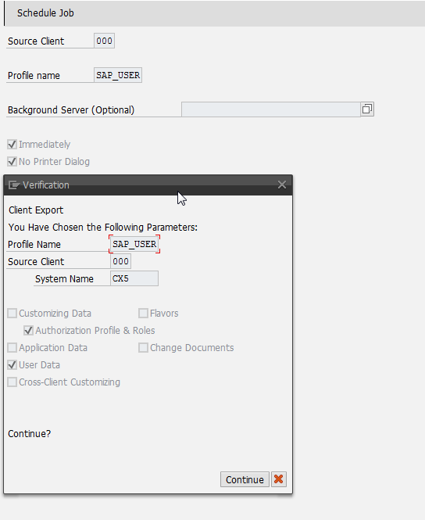
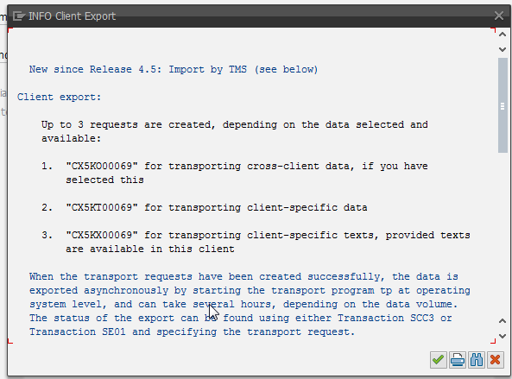

Pre-Refresh Activities
Export User Master

Slide 15
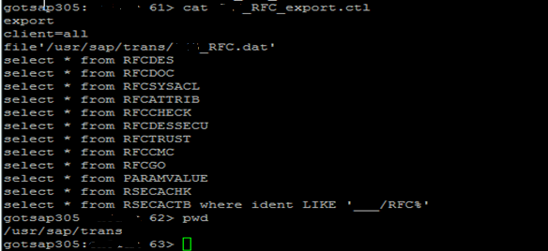

Pre-Refresh Activities
Export RFC Destinations

Slide 16
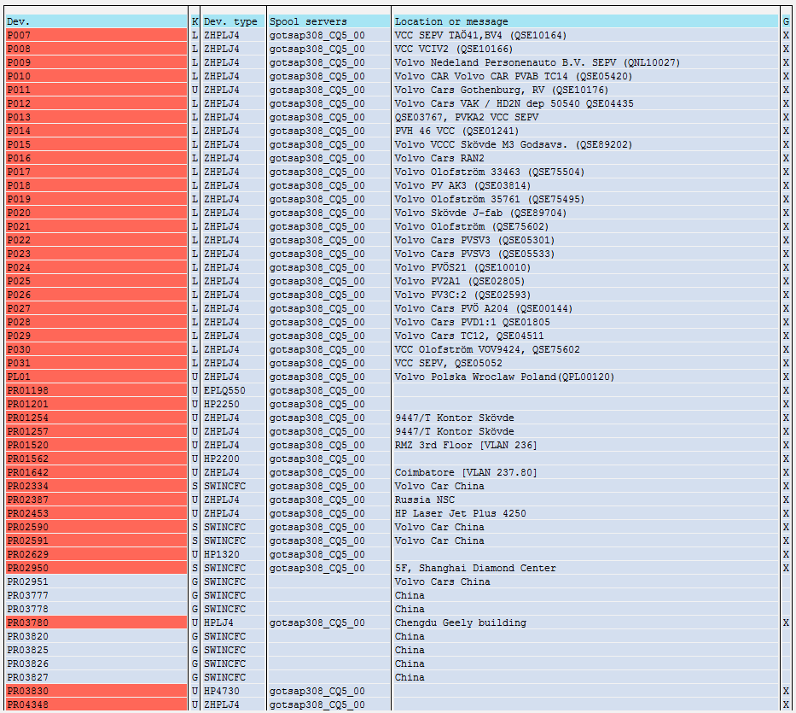
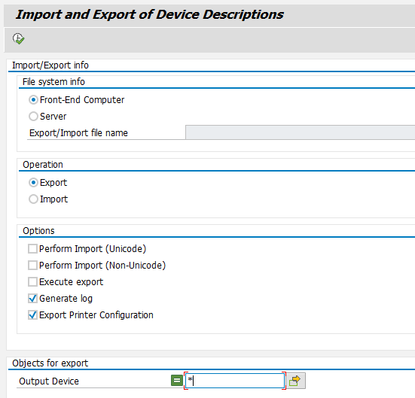
Pre-Refresh Activities
Export Printer Definitions

Slide 17
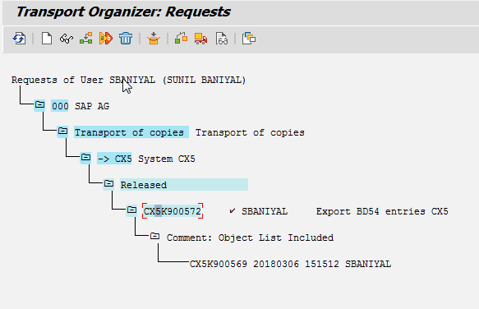
Pre-Refresh Activities
Export Logical System Name

Slide 18

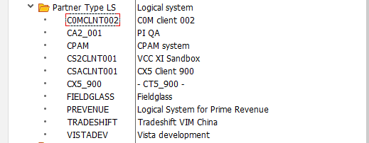
Pre-Refresh Activities
Export Partner Profiles

Slide 19
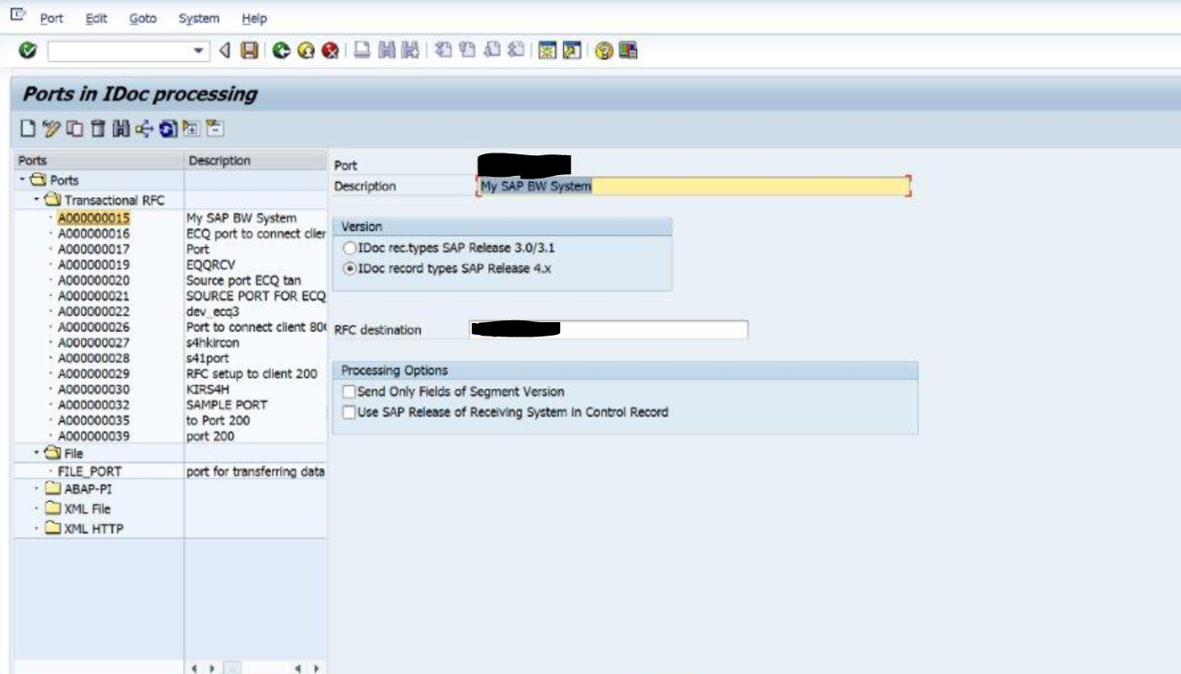
Pre-Refresh Activities
Export Partner Profiles (we21)

Slide 20
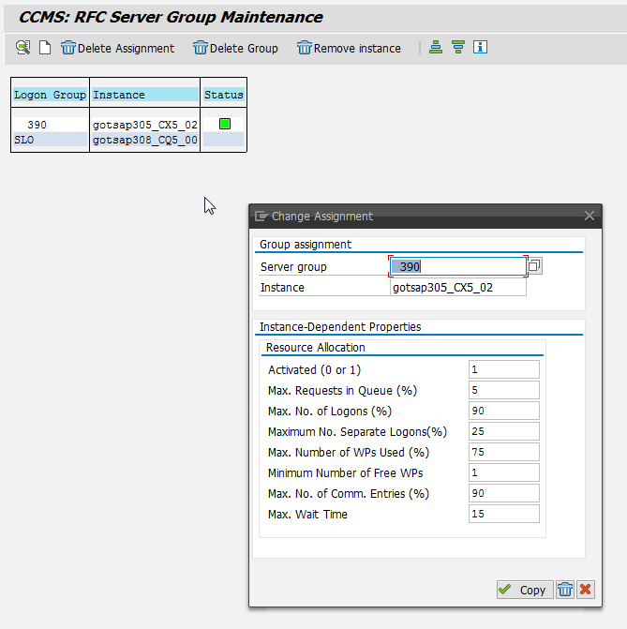


Pre-Refresh Activities
Save Logon Groups RZ12

Slide 21
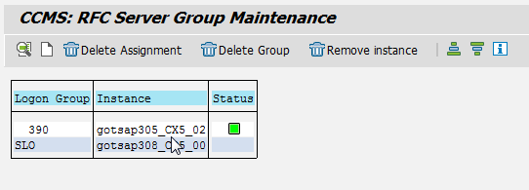
Pre-Refresh Activities
RFC Groups SAP Basis Screenshots

Slide 22
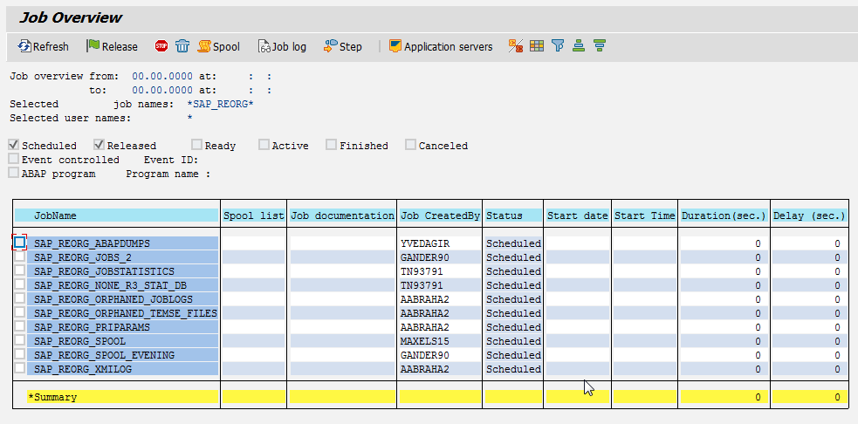
Pre-Refresh Activities
Clean up Job Log Directory

Slide 23
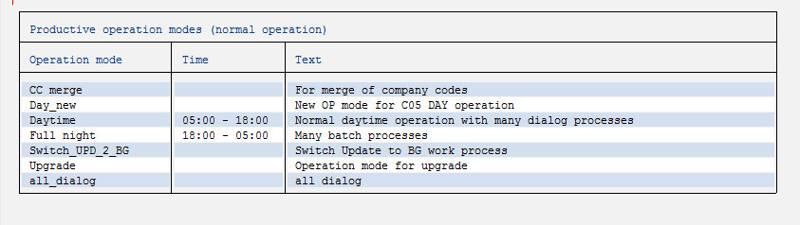

Pre-Refresh Activities
Operation Mode Configuration SAP Basis Screenshot

Slide 24
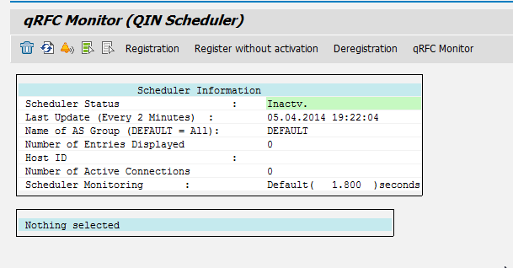
Pre-Refresh Activities
Export Web Service Configuration
Export tRFC and Outbound qRFC Configuration

Slide 25
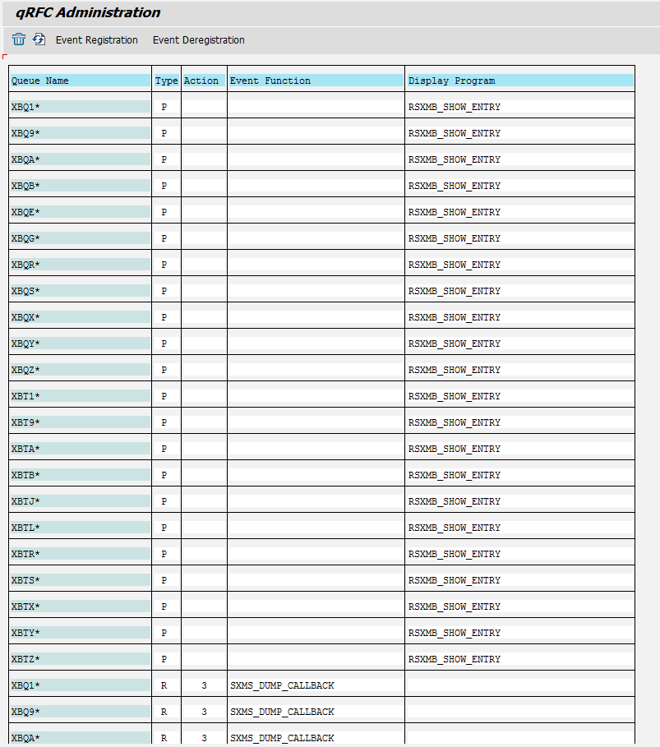
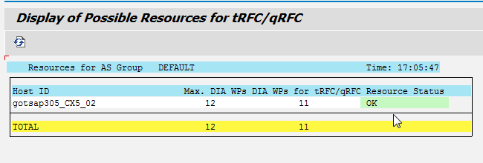
Pre-Refresh Activities
Export tRFC and Outbound qRFC Configuration

Slide 26
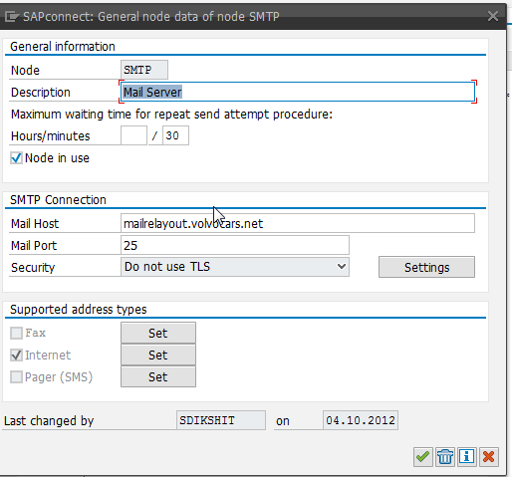
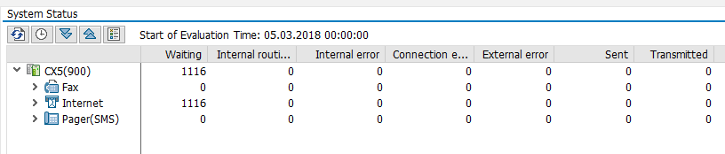
Pre-Refresh Activities
Export SCOT Configuration

Slide 27
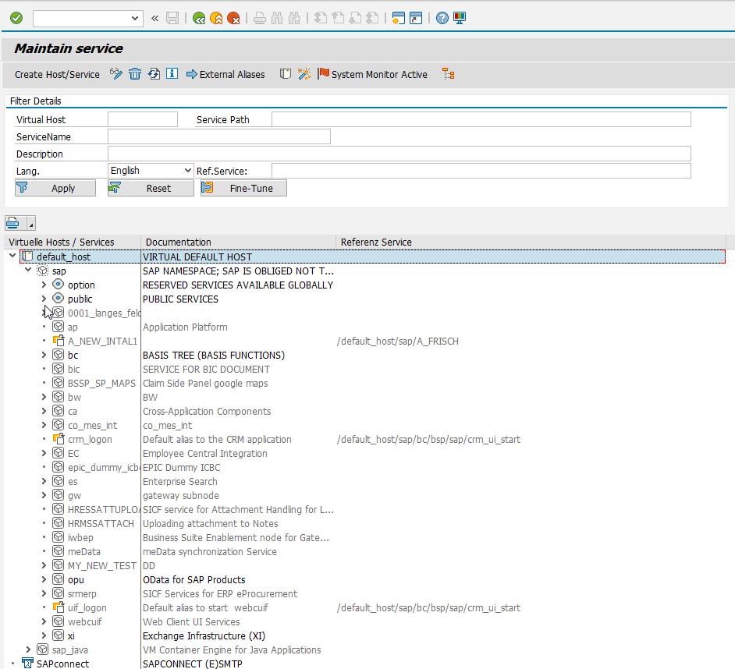
Pre-Refresh Activities
Export SICF Configuration

Slide 28
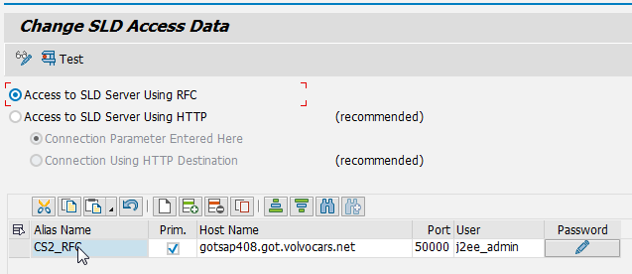
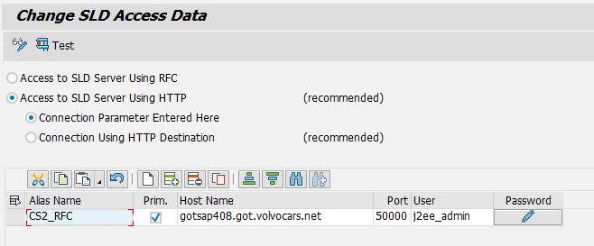
Pre-Refresh Activities
Export SLDAPICUST Configuration

Slide 29



Pre-Refresh Activities
Export STRUST Configuration
Export Cross-Client FileName/Path Configurations

Slide 30
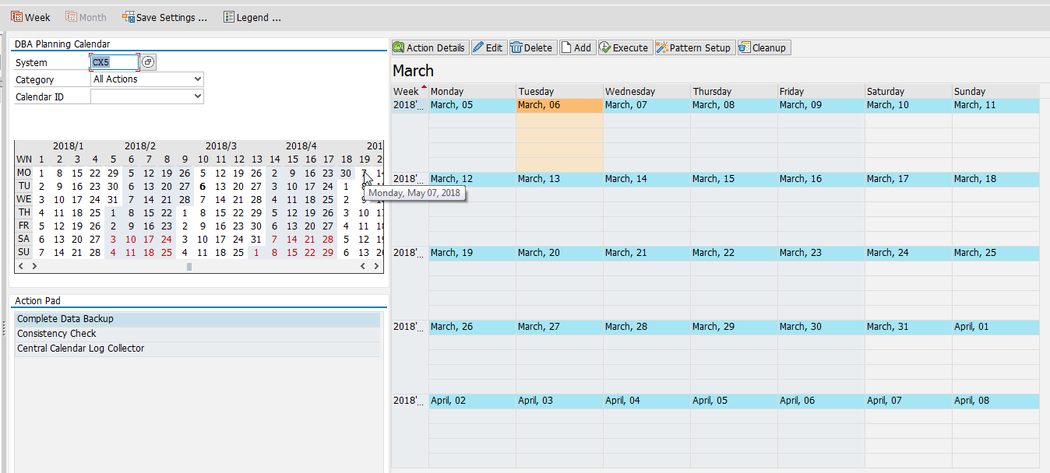
Pre-Refresh Activities
Export DBACOCKPIT Configurations

Slide 31
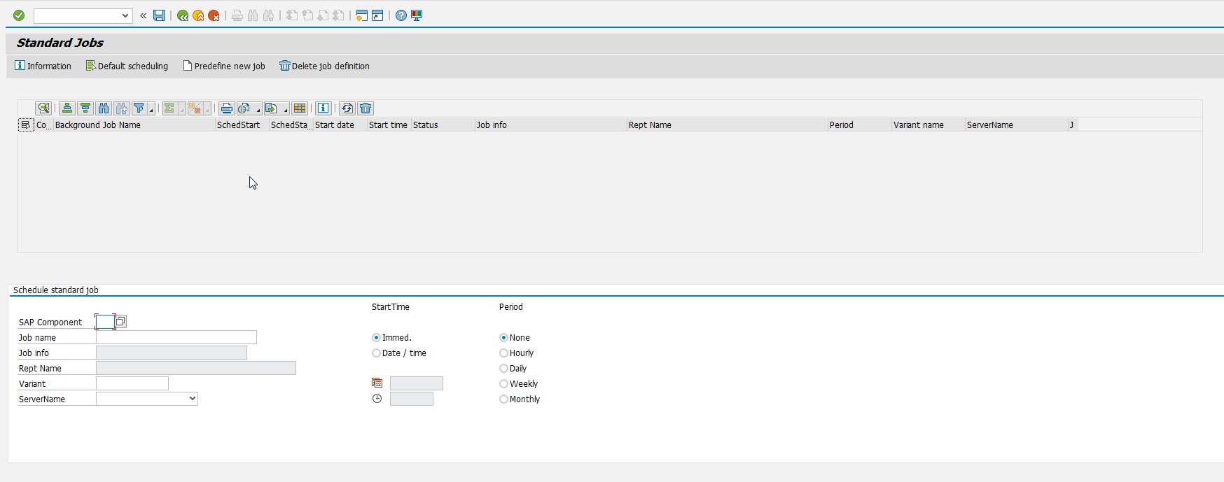
Pre-Refresh Activities
Export Batch Job Variants
Export Batch Job Server Configurations
Export OS Commands

Slide 32
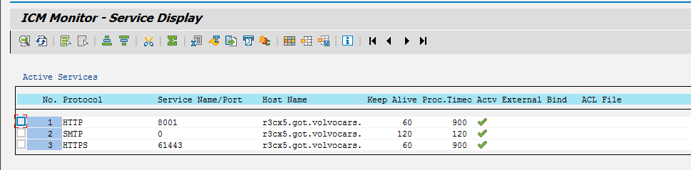
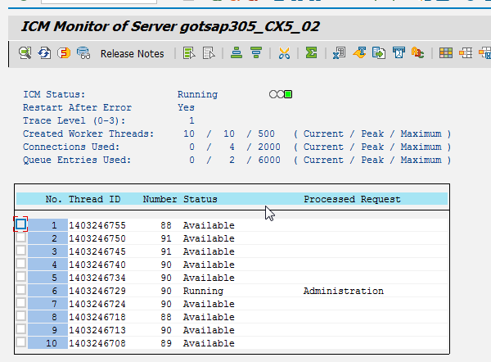
Pre-Refresh Activities
Check SMICM

Slide 33
Pre-Refresh Activities
Secure the required passwords of OS users ; <sidadm>
Secure the required passwords of Application Users ; DDIC/000
Secure the required passwords of DB users; SYSTEM; SCHEMA users
Download required license for Target and have it stored on OS Level
Take a screenshot of Database - just to have it handy to retain incase of issues
Send out a communication to all required stakeholders about the downtime
Set a system message sm02 with the timelines & unavailability
Secure a database backup of the system before starting the activity
Disconnect the system from CUA

Slide 34
Database Copy(Restore and Recovery)

Slide 35
DB Restore
Stop SAP Application, Database and Listener.
Stop the SAP application from OS level using Command “stopsap R3”
Delete the existing datafiles from Target database and rename current control files on target system
Restore backup
Recover the database
Create Control file.
Start SAP application
Lock all the production users
Set SAP background process to 0 and Suspend all the jobs.
Restart SAP application

Slide 36
Post- Refresh Activity

Slide 37
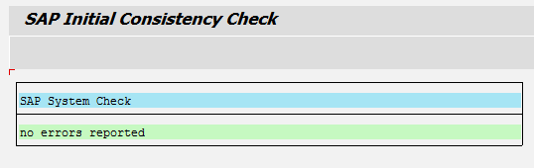
Post- Refresh Activity
Disable RFCs
Disable Edi Ports
Truncate TRFC and QRFC tables
Truncate profile tables
Truncate BG RFC tables
Apply SAP licenses
Initial Consistency Check

Slide 38
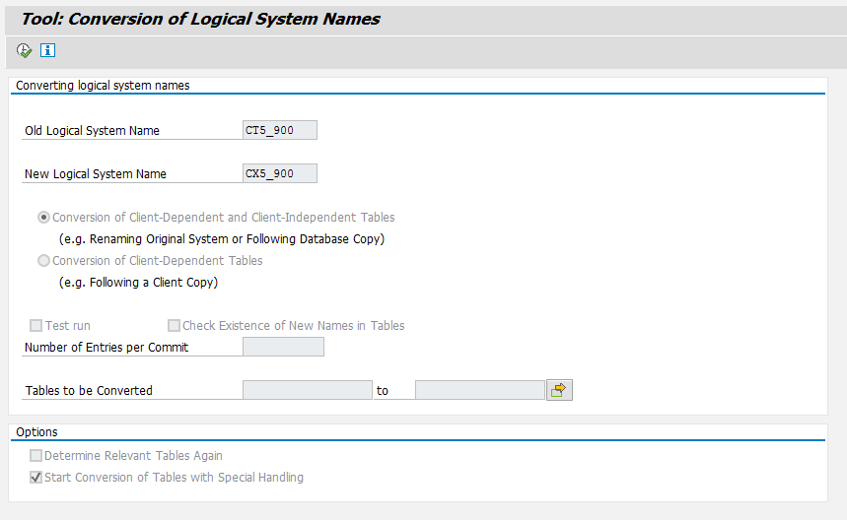
Post- Refresh Activity
Logical System Conversion – BDLS

Slide 39
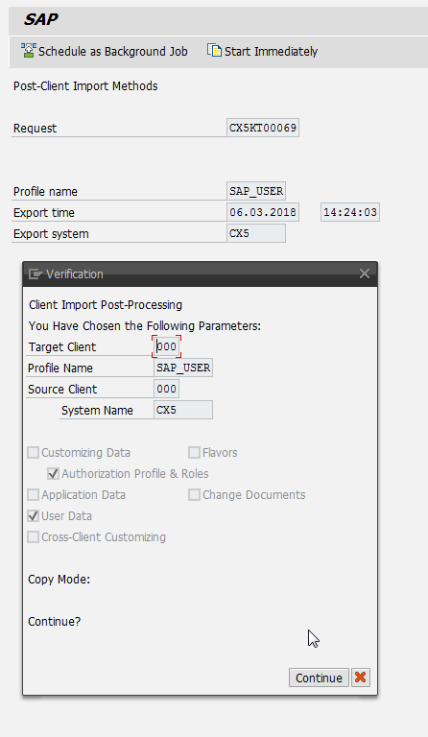
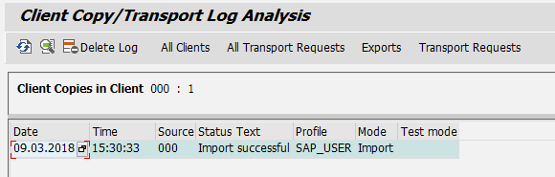
Post- Refresh Activity
Check and import RFC destinations
Import user master

Slide 40
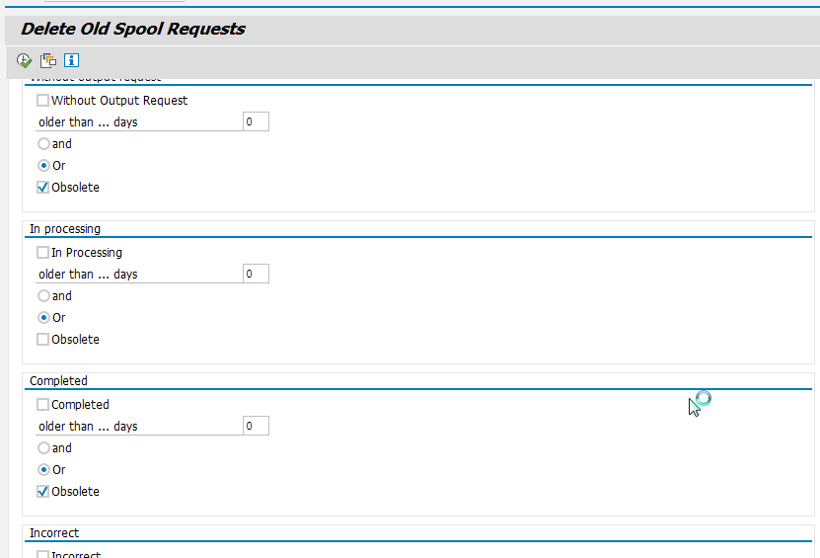
Post- Refresh Activity
Add System back to CUA
Reconfigure spool

Slide 41
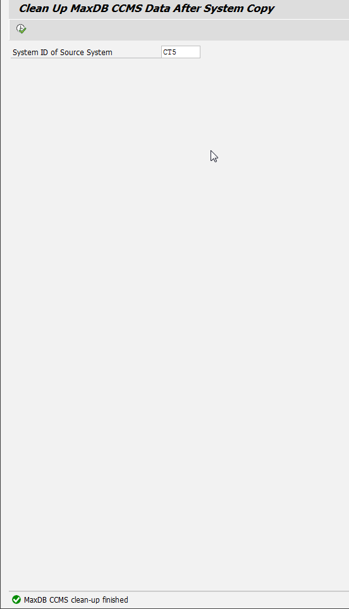
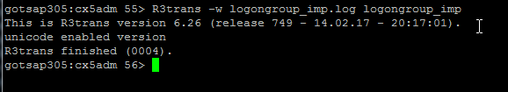
Post- Refresh Activity
Clean CCMS data
Change logon groups

Slide 42
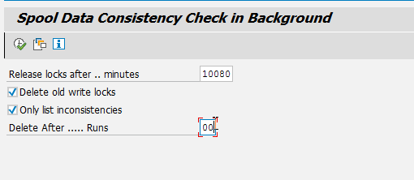
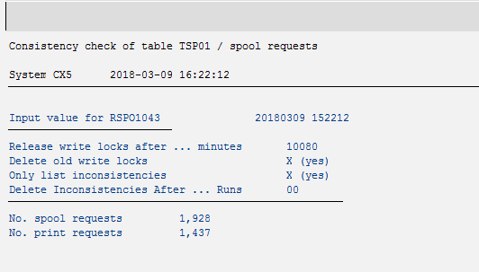
Post- Refresh Activity
Change RFC server groups
TemSe Consistency Check

Slide 43
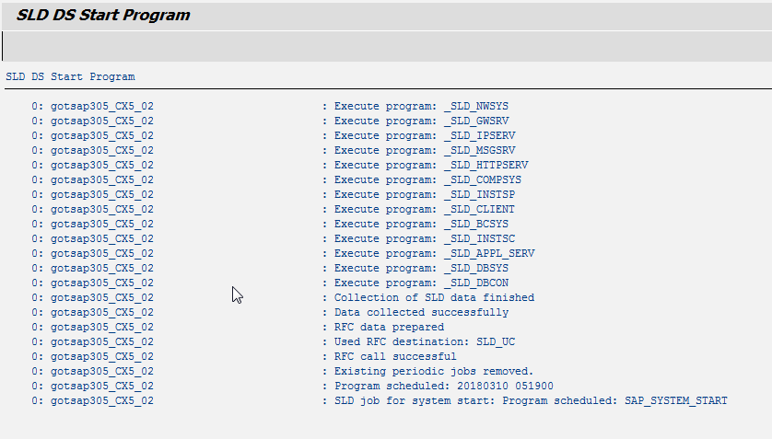
Post- Refresh Activity
Schedule Standard jobs
Connect to SLD

Slide 44

Post- Refresh Activity
Verify operation modes in RZ04
SSO Certificates
Generate load SGEN
Check the DB planning calendar
Disable Email Functionality
Check the Integrations

Slide 45
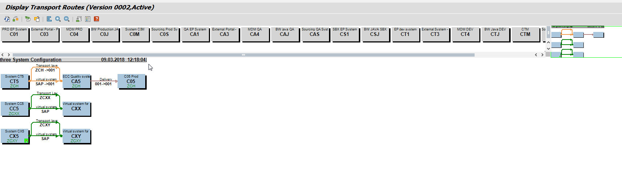
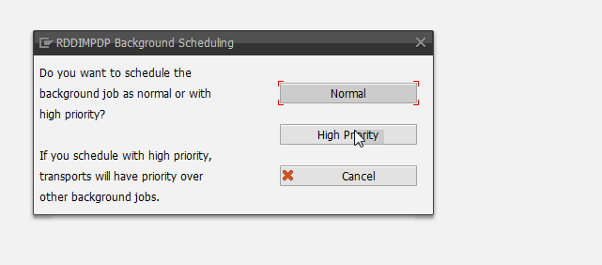
Post- Refresh Activity
Retain the STMS configuration as before

Slide 46
Post- Refresh Activity
Import any add-ons (if any)
Import any TR's (provided by Projects i.e. in-flight transports)
Check the Integrations - RFC's & PROXY to PI and any other 3rd party interface observed during prechecks.
Configure Database Backup
Release system to users

Slide 47
Questions
?

